Slide 1
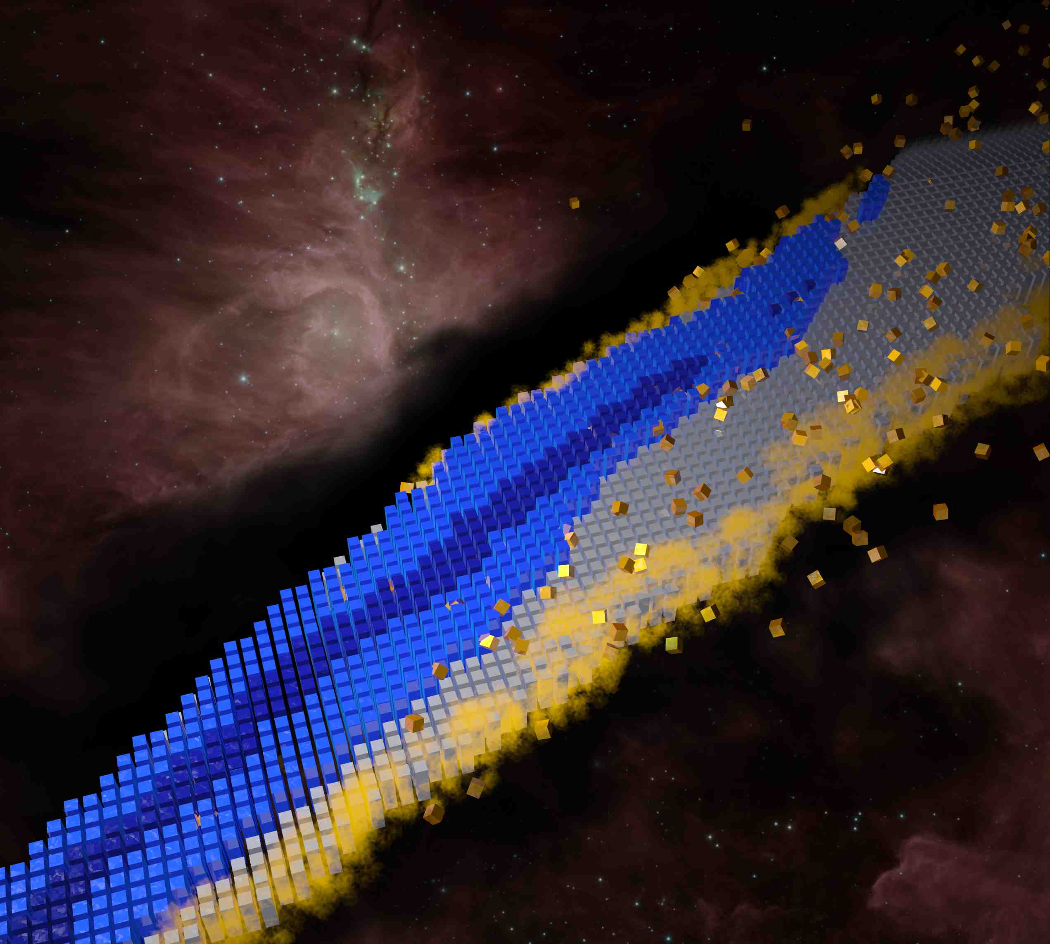
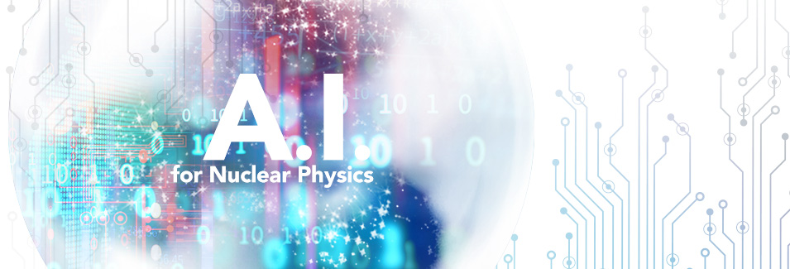
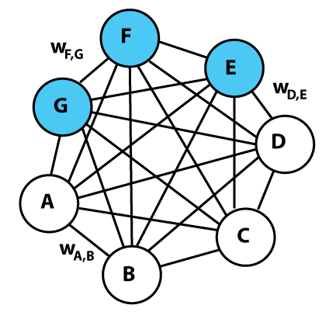
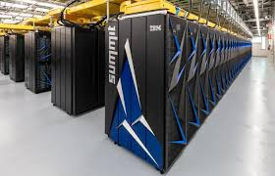
Survey: Status of A.I. in Nuclear Structure Theory
Witold Nazarewicz & Dean Lee, Michigan State University/FRIB
A.I. for Nuclear Physics workshop
4-6 March 2020
CEBAF Center
Notes:
Machine learning (automated processes that learn by example in order to classify, predict, discover, or generate new data)
Artificial intelligence (methods by which a computer makes decisions or discoveries that would usually require human intelligence)
https://towardsdatascience.com/no-machine-learning-is-not-just-glorified-statistics-26d3952234e3
https://towardsdatascience.com/the-actual-difference-between-statistics-and-machine-learning-64b49f07ea3
https://www.nature.com/articles/nmeth.4642
https://machinelearningmastery.com/relationship-between-applied-statistics-and-machine-learning/

Slide 2
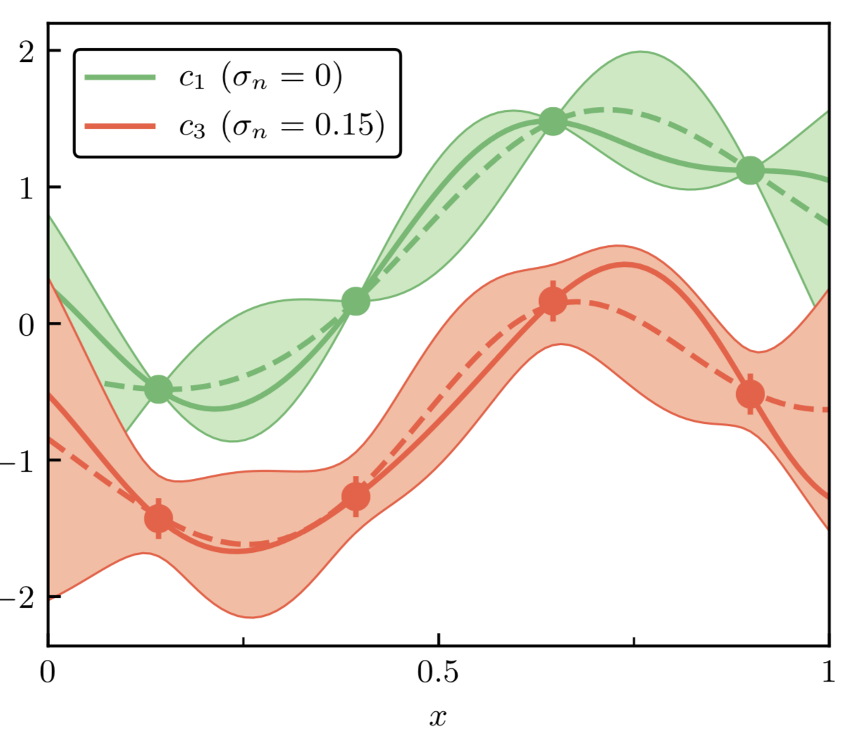
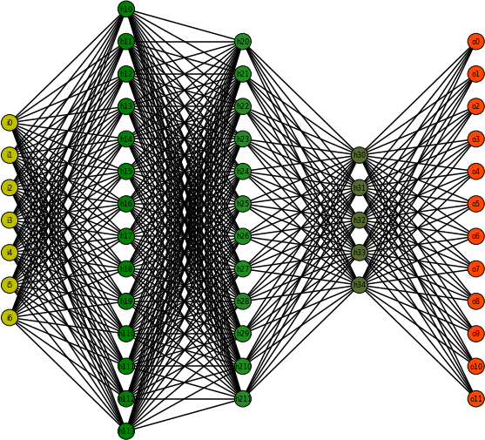
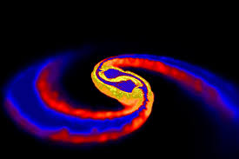
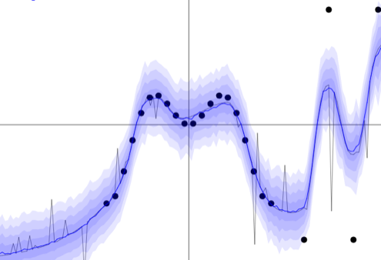
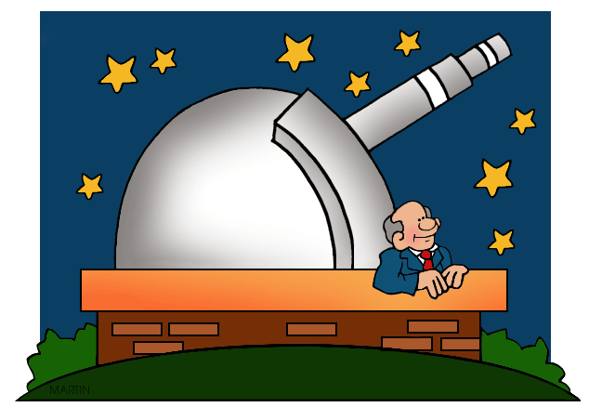
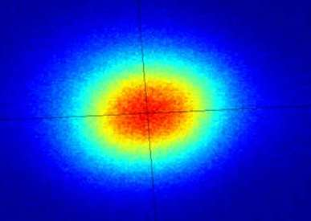
Guiding principle: the scientific method
Facilitating discoveries!

Slide 3
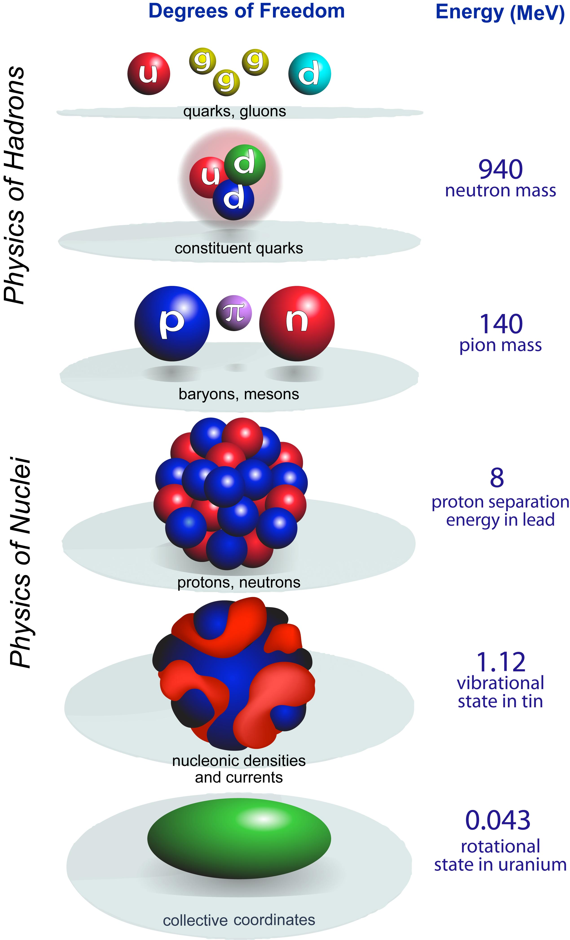
scale
separation
LQCD
Nuclear structure
Nuclear reactions
New standard model
Societal applications
quark
models
Resolution
A-body
Effective Field Theory
CI
coupled integro-differential equations in 3A dimensions
DFT
Hilbert-space truncations necessary
collective
Notes:
All nuclear models are phenomenological but at different resolution

Slide 4
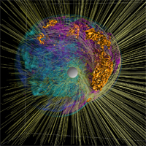
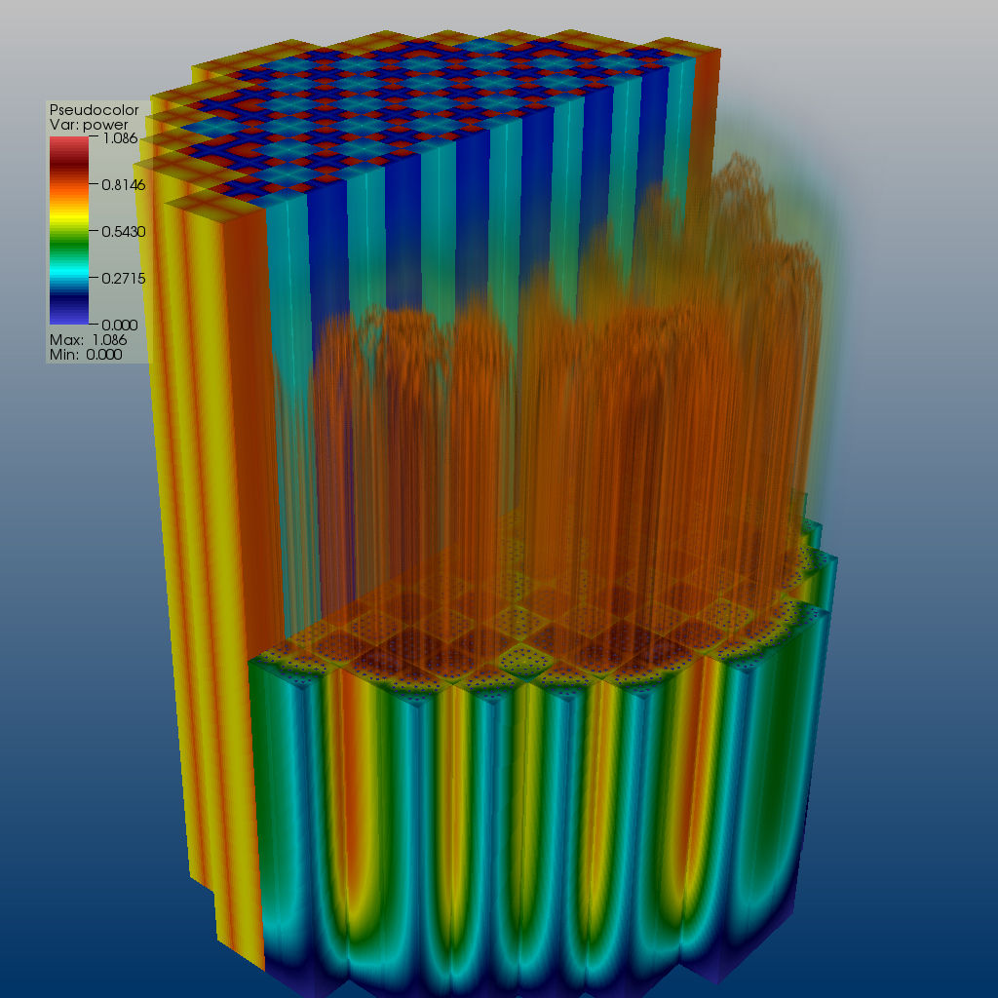
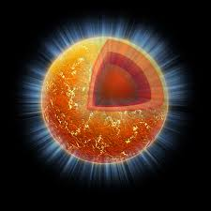

AI & low-energy nuclear theory: Why?
AI tools can help us to speed up the scientific process cycle and hence facilitate discoveries: Beam time and compute cycles are expensive.
Enabling fast emulation for big simulations
Revealing the information content of measured observables
Identifying crucial experimental data for better constraining theory
AI tools can help us to reveal the structure of our models
Parameter estimation with heterogeneous/multi-scale data
Model reduction
Uncertainty quantification
AI tools can help us to provide predictive capability
Theoretical results often involve ultraviolet and infrared extrapolations due to Hilbert-space truncations
Providing meaningful input to applications and planned measurements
Theoretical models are often applied to entirely new nuclear systems and conditions that are not accessible to experiment
Notes:
Infrared divergences arise from the propagator (large distances, small energy), whereas ultraviolet divergences appear from the upper limit of integration (short-distance physics).

Slide 5
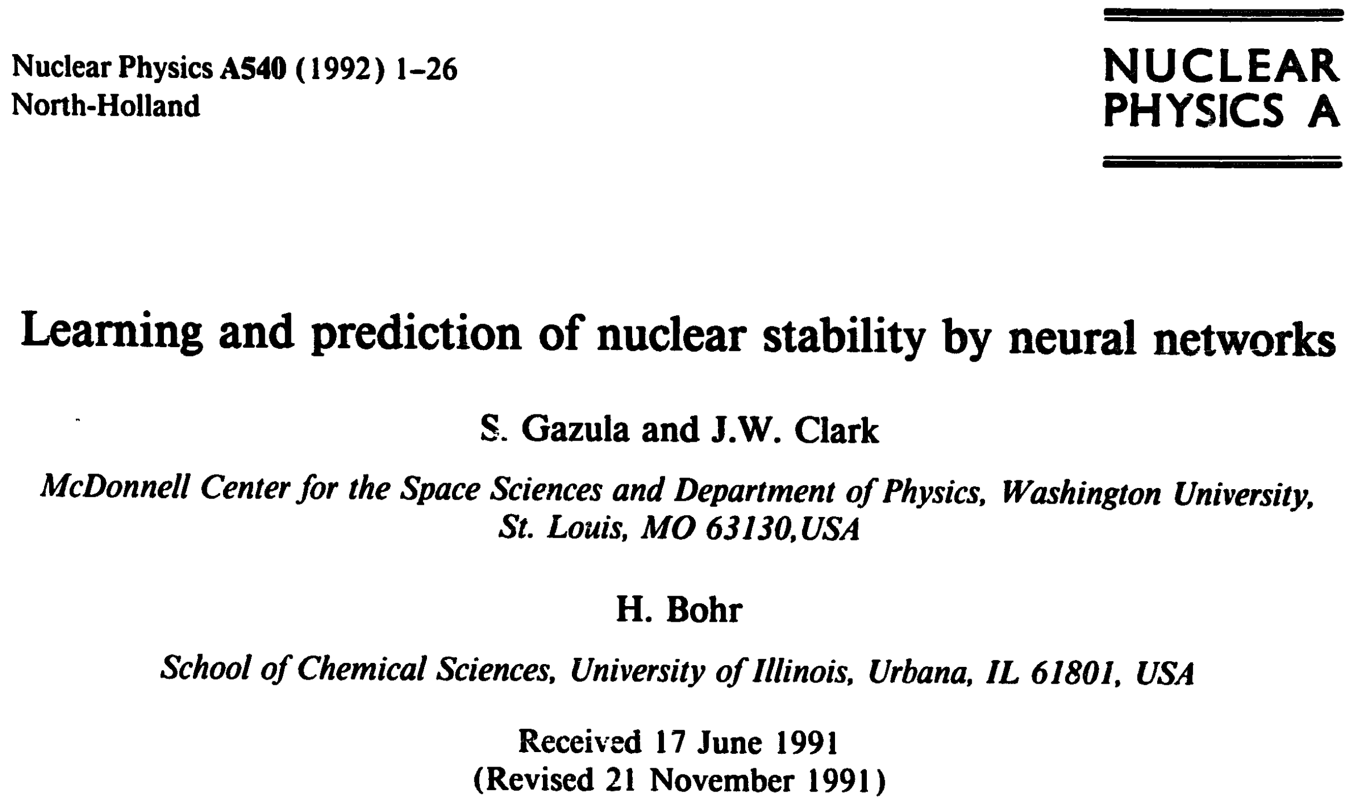
Early applications of neural networks: 1992-2015
The backpropagation learning algorithm is used to teach layered feedforward networks of model neurons the existing data on nuclear stability and atomic masses. Specific applications include (i) the construction of networks that decide stability, (ii) learning and prediction of nuclear mass excesses and (iii) analysis of the systematics of neutron separation energies. With suitable architecture and representation of input and output data, learning can be accomplished with high accuracy. Evidence is presented that these
new adaptive computational systems can grasp essential regularities of nuclear physics including the valley of β-stability, the pairing effect and the existence of shell structure. Significant predictive ability is demonstrated, opening the prospect that neural networks may provide a valuable new tool for computing nuclear properties and, more broadly, for phenomenological description of complex many-body systems.
Several applications of NN to various nuclear structure problems by Clark and his collaborators, including: nuclear systematics^{1,2}; backpropagation algorithm for training NN³; Nuclear mass systematics⁴; Global properties: Support Vector Machines⁵
¹Phys. Lett. B 300, 1 (1993); ²Neural Networks 8, 291 (1995); ³CPC 88, 1 (1995);
⁴Nucl. Phys. A 743, 222 (2004); ⁵IJMP B 20, 5015 (2006)

Slide 6
The current universe of AI applications to nuclear structure theory
BC=Bayesian calibration; BGP=Bayesian Gaussian processes; BMA=Bayesian model averaging;
BNN=Bayesian neural networks; RBF=Radial basis function
Recent applications
Nuclear structure
Masses: NN¹; RBF, BNN²; Multilayer Perceptron NN³; BNN^{4,5,6}
¹Ann. Nucl. Energy 63, 172 (2014); ²Phys. Rev. C 100, 054311 (2019);
³1912.11365; ⁴Phys. Rev. C 93, 014311 (2016); ⁵Phys. Rev. C 97, 014306 (2018);
⁶Phys. Lett. B 778, 48 (2018)
Mass extrapolations: BGP, BNN¹; BGP, BMA²; BGP, BMA³; BGP, BMA⁴
¹Phys. Rev. C 98, 034318 (2018); ²Phys. Rev. Lett. 122, 062502 (2019);
³Phys. Rev. C 101, 014319 (2020); ⁴2001.05924
Masses for r-process: BC¹
¹1901.10337
Charge radii: naïve BNN¹; NN²; BNN³
¹Phys. Rev. C 101, 014304 (2020); ²J. Phys. G 40, 055106 (2012); ³Phys. Rev. C 96, 044308 (2017)
Excited states with CI: shell model with BC¹; NN²
¹Phys. Rev. C 98, 061301(R) (2018), 1907.04974; ²2001.08561
Excited 2⁺ states: NN¹
¹2002.08218

Slide 7
Recent applications of AI (cont.)
BC=Bayesian calibration; BGP=Bayesian Gaussian processes; BMA=Bayesian model averaging;
BNN=Bayesian neural networks; RBF=Radial basis function
Nuclear structure: Dealing with Hilbert-space truncations
Nucleon-nucleon phase shifts in EFT: BC¹
¹J. Phys. G 46, 045102 (2019)
Collective states: emulating beyond-DFT with committee of deep NN¹
¹1910.04132
Potential Energy Surfaces: feedforward NN¹
¹Phys. Part. Nucl. Lett. 10, 528 (2013)
Truncation errors in EFT: BGP^{1,2}
¹Phys. Rev. C 100, 044001 (2019); ²Phys. Rev. C 96, 024003 (2017)
Finite-size corrections to A-body models: NN¹; feedforward NN²
¹Phys. Rev. C 100, 054326 (2019); ²Phys. Rev. C 99, 054308 (2019)
A-body models: Subspace projected A-body technique¹; BC^{2;} feedforward NN³
¹Phys. Rev. Lett. 123, 252501 (2019); ²1912.02227; J. Phys. G 46 095101 (2019);
³arXiv:1911.13092
Nuclear structure: model reduction
Mass model structure: BC, BGP, BMA¹
¹2002.04151

Slide 8
Recent applications of AI (cont.)
BC=Bayesian calibration; BNN=Bayesian neural networks; RBF=Radial basis function;
SVM=Support Vector Machines
Nuclear decays
Beta-decay for r-process: BNN¹
¹Phys. Rev. C 99, 064307 (2019)
Beta decay half-lives: SVM, feedforward NN¹
¹0809.0383 [nucl-th]
Alpha decays: BNN^{1,2}; NN³
¹J. Phys. G 46, 115109 (2019); ²EPL 127, 42001 (2019); ³1910.12345
Evaluation of incomplete fission yields: BNN¹ and mixture-density NN²
¹Phys. Rev. Lett. 123, 122501 (2019); ²EPJ Web Conf. 211, 04006 (2019)
Nuclear reactions
UQ for direct nuclear reactions: BC^{1,2,3}
¹Phys. Rev. Lett. 122, 232502 (2019); ²Phys. Rev. C 97 064612 (2018);
³Phys. Rev. C 100, 064615 (2019)
Cross sections in proton induced spallation reactions: BNN¹ ¹Chinese Phys. C 44, 014104 (2020)
Fusion reaction cross-sections: NN¹
¹NIM B 462, 51 (2020)

Slide 9
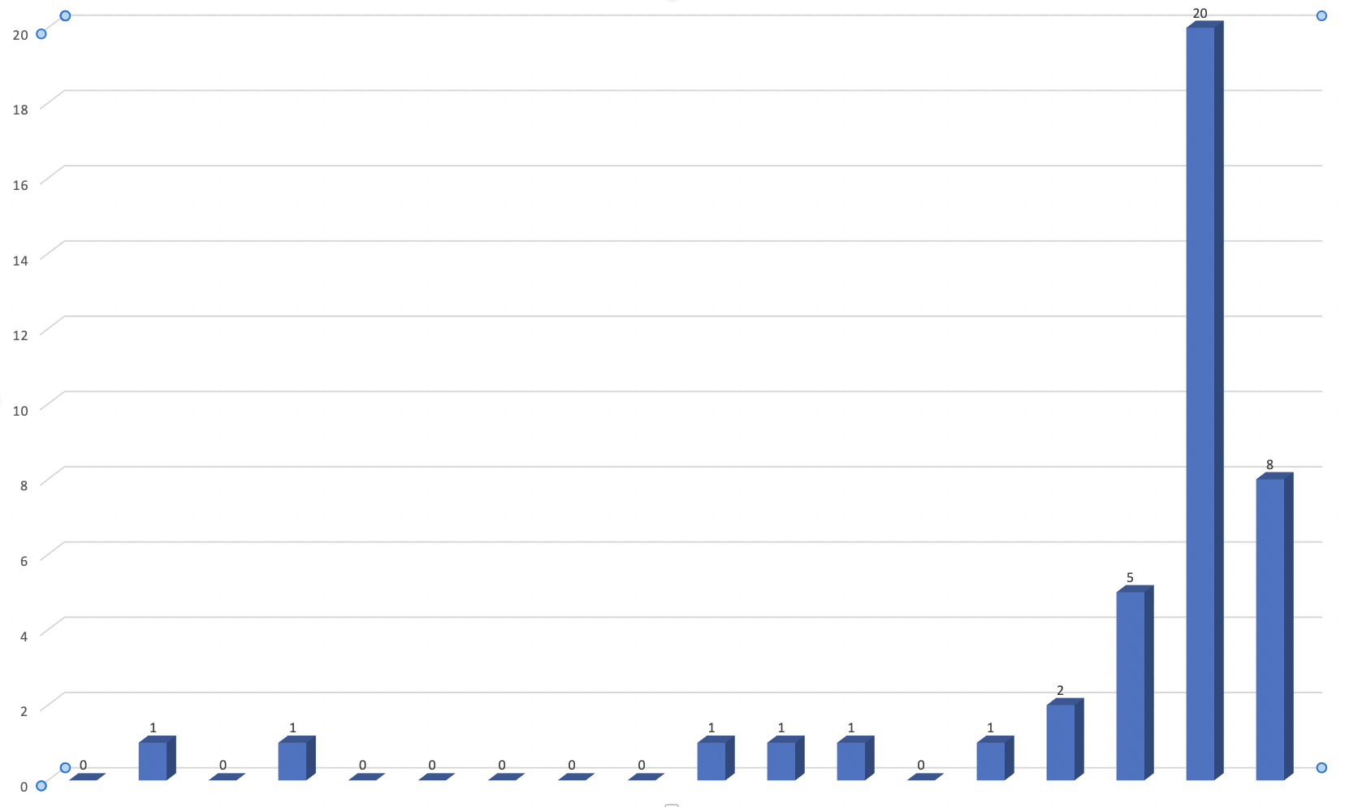
Number of nuclear structure theory AI papers
Early work by J.W. Clark et al.
1992
2004
2020

Slide 10
EXAMPLES
AI for Nuclear Structure Theory

Slide 11
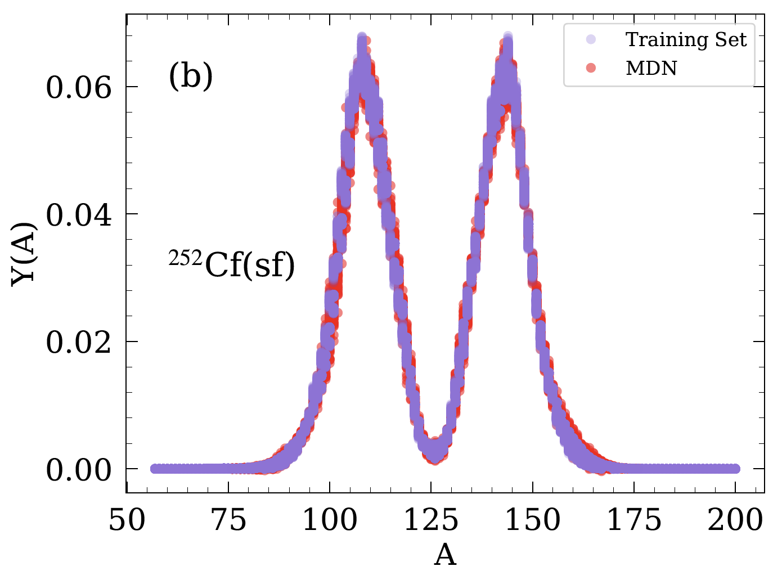
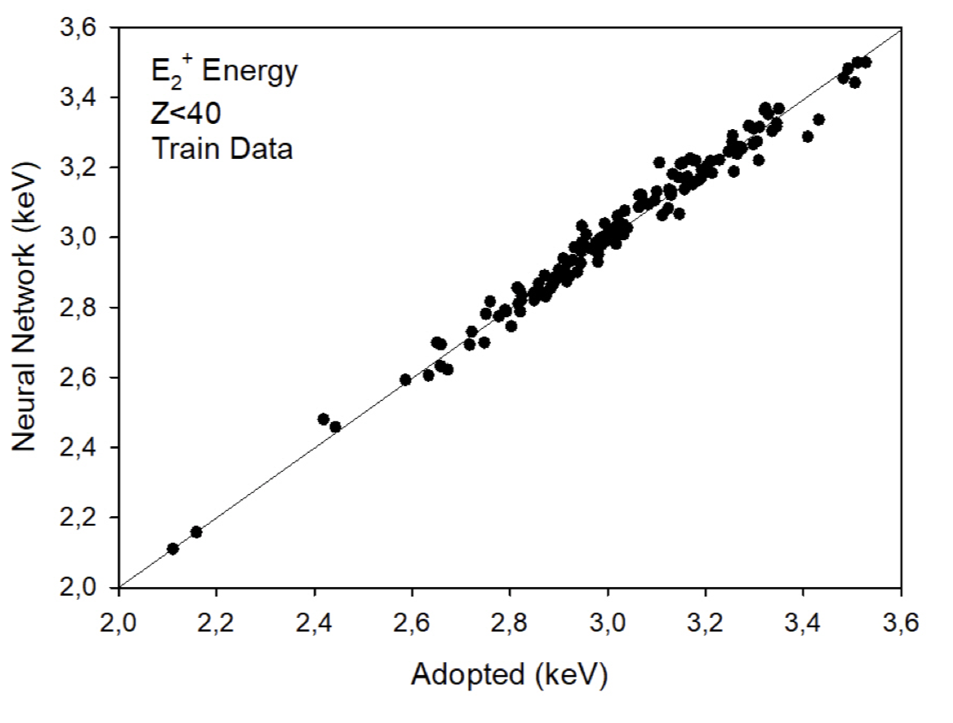
Interpolations: Computing “missing” observables
Fission fragment yields with mixture-density NN
A. Lovell et al., EPJ Web Conf. 211, 04006 (2019) and to be published
2⁺ states with ANN
Akkoyun and Kaya, 2002.08218

Slide 12
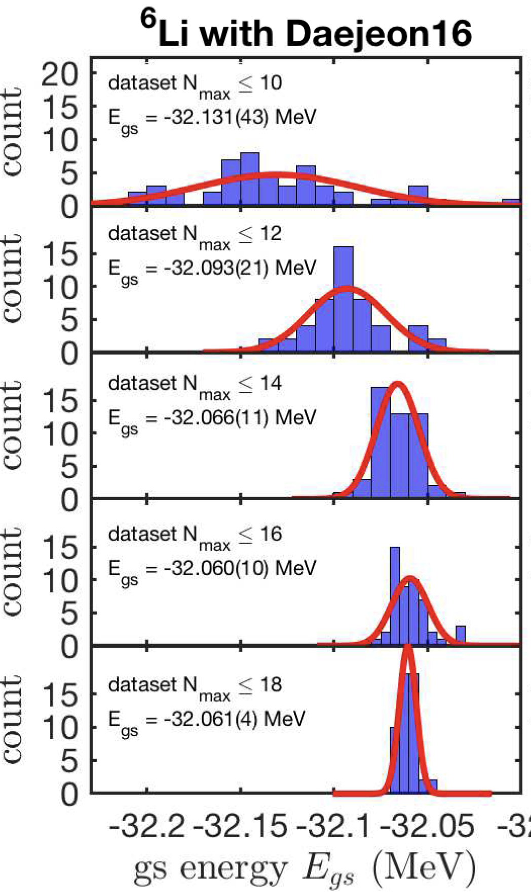
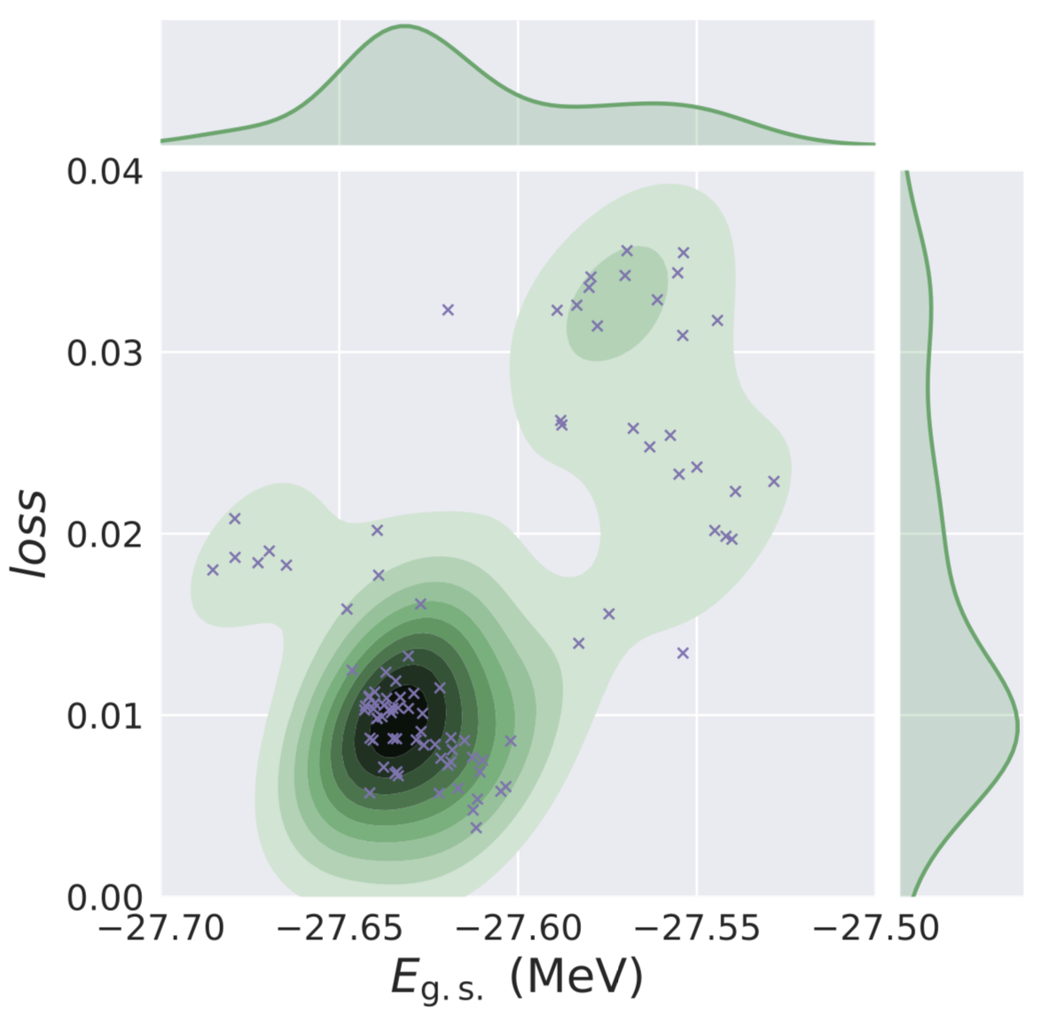
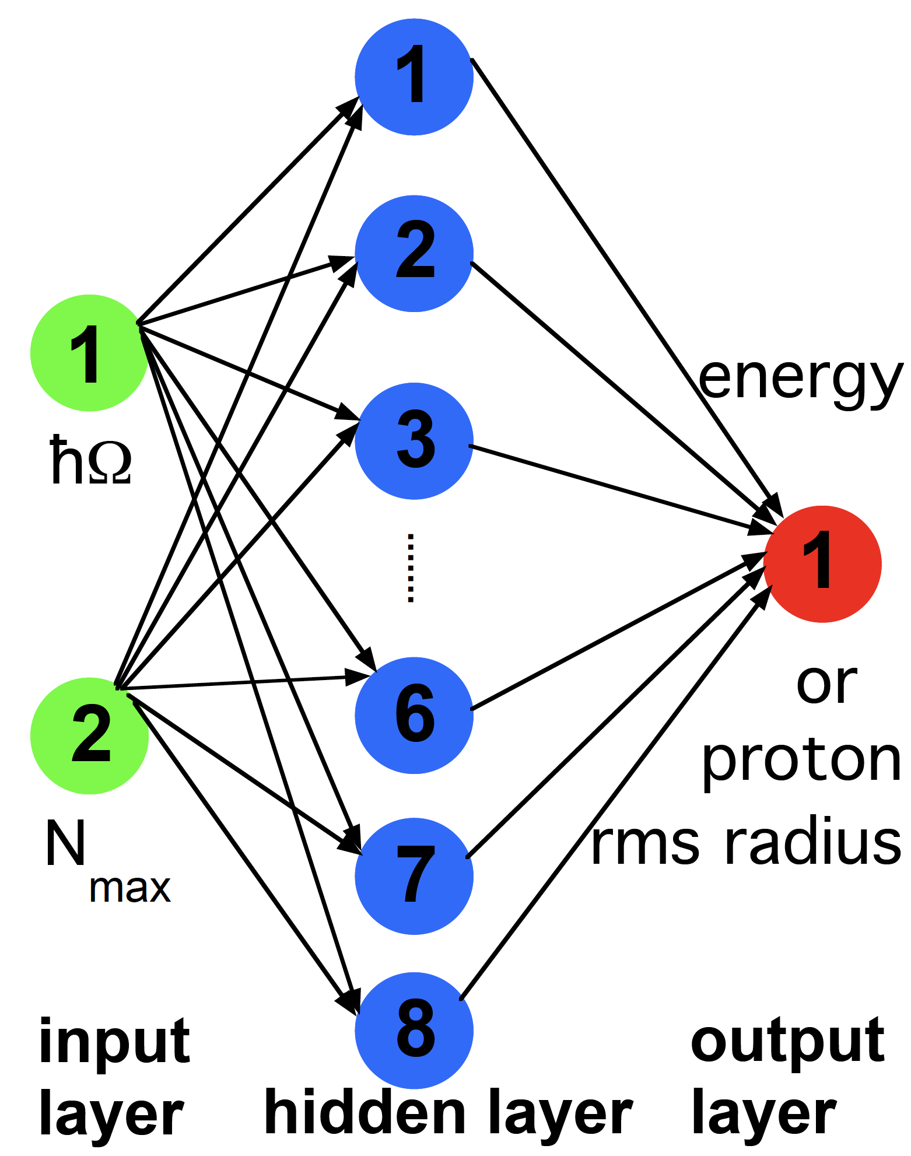
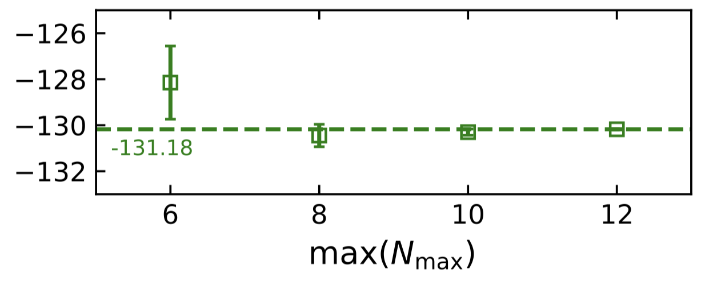
Extrapolations of A-body results with ANN
Negoita et al. Phys. Rev. C 99, 054308 (2019)
Jiang et al. Phys. Rev. 100, 054326 (2019)
⁴He with NCSM+NNLO_{opt}
NCSM
¹⁶O with CC+NNLO_{opt}
Topological structure of the feed-forward artificial neural network used

Slide 13
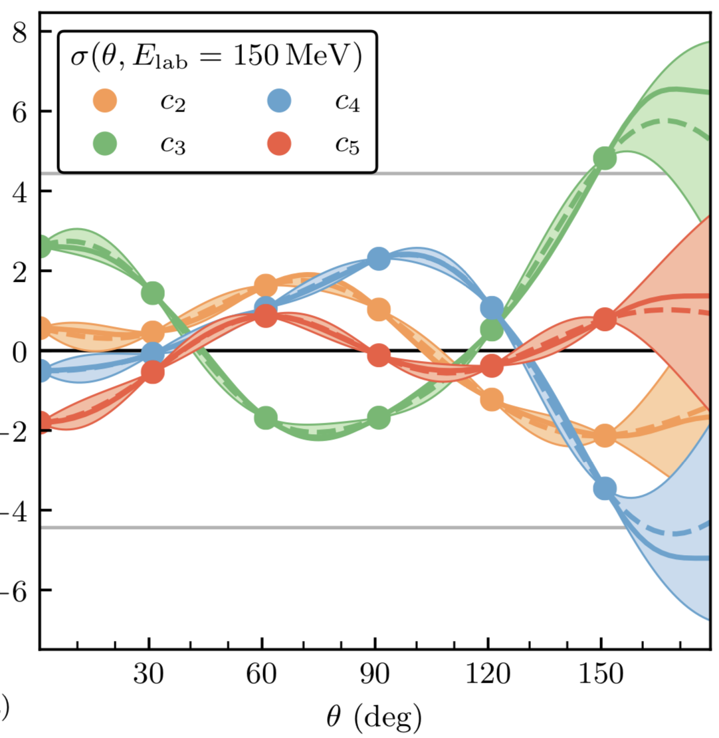
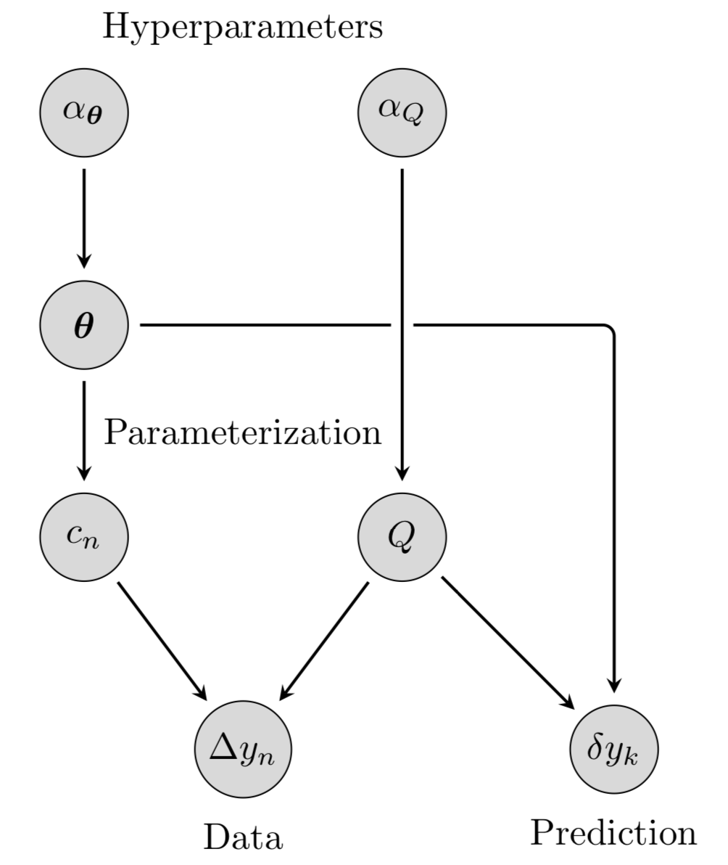
Bayesian GP model for Quantifying Correlated Truncation Errors in EFT
Melendez et al., Phys. Rev. C 100, 044001 (2019)
Differential NN cross section coefficients from the semilocal EKM potential
Bayesian network used

Slide 14
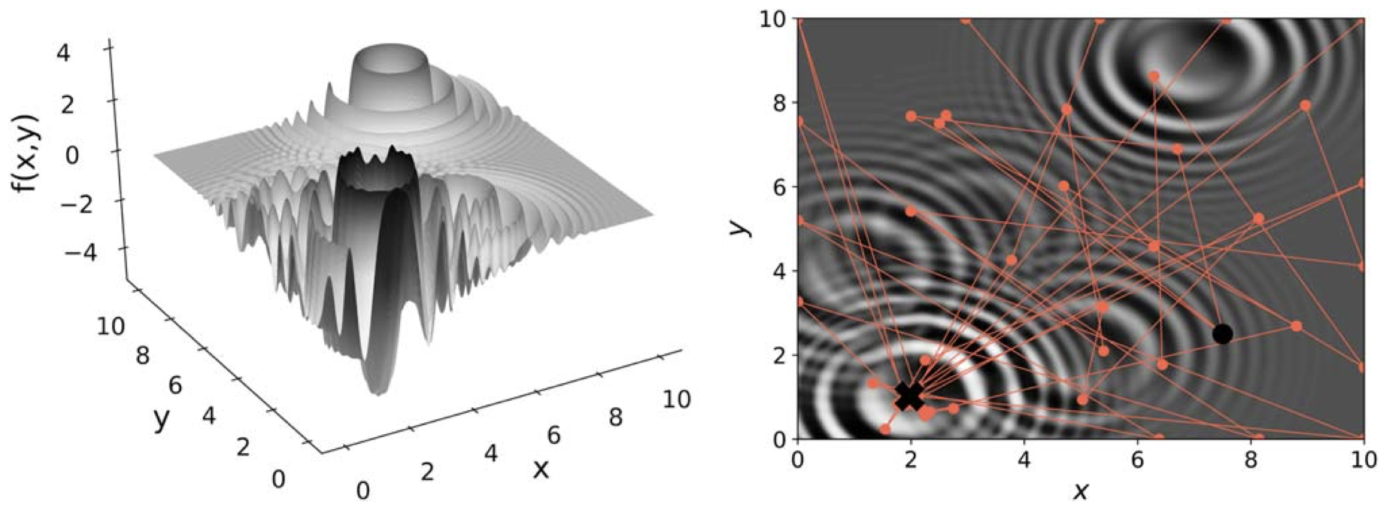
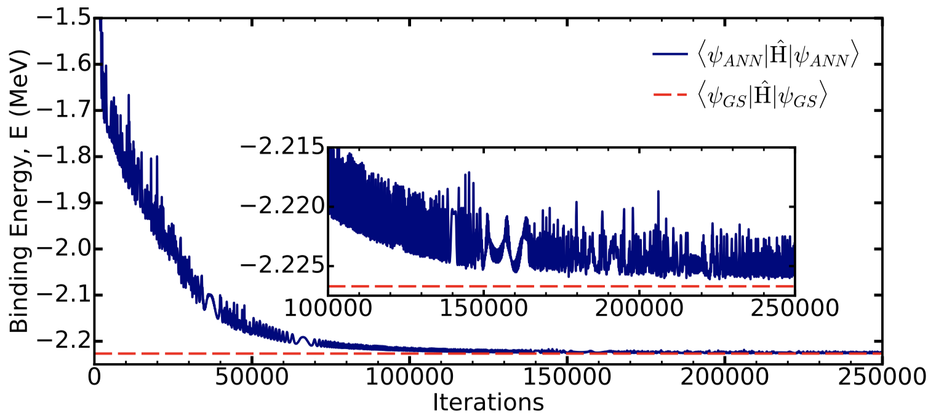
Bayesian optimization in ab initio nuclear physics
Ekström et al., J. Phys. G 46 095101 (2019)
The trace (red dots connected by red lines) of 50 BayesOpt iterations with a Matern 3/2 GP kernel and expected improvement acquisition function for finding the unique global minimum (cross) of the Langermann function.
Machine learning (variational ANN) for the deuteron
Keeble and Rios, 1911.13092
Wave function optimization: a network with 6 hidden nodes can provide a faithful representation of the ground state wave function, with a binding energy that is reproduced to better than 0.1 %

Slide 15
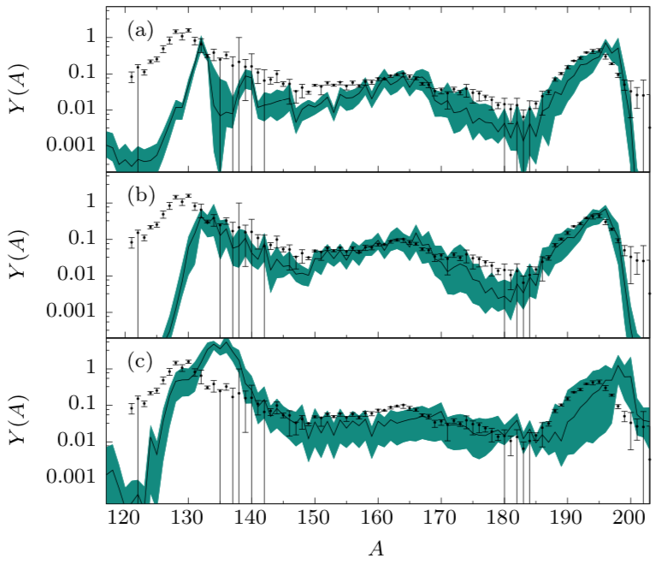
Parameter estimation : Quantified DFT
McDonnell et al.
Phys. Rev. Lett. 114, 122501 (2015)
Sprouse et al.
arXiv 1901.10337
Simulated r-process abundances with astrophysical conditions corresponding to high-entropy (a), low-entropy (b), and fission-recycling (c).
Bivariate marginal estimates of the posterior distribution for the 12-dimensional DFT UNEDF₁ parameterization.

Slide 16
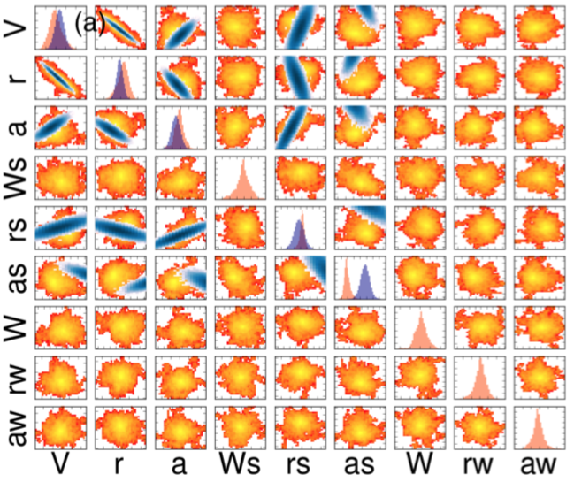
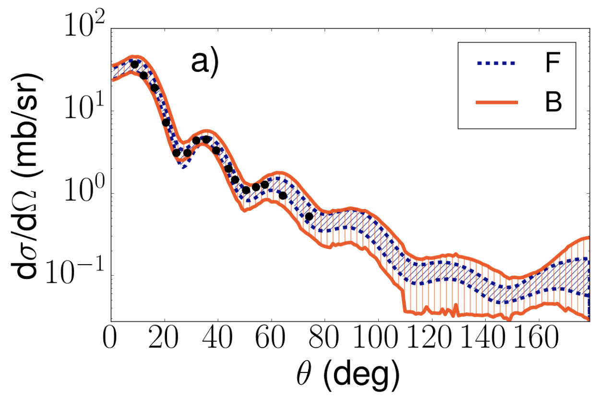
Parameter estimation: Direct reactions
King et al. Phys. Rev. Lett. 122, 232502 (2019)
Transfer cross sections for ⁴⁸Ca(d,p): the predicted 95% credibility intervals from the Bayesian method and the confidence interval from the regression approach.
Bivariate marginal estimates of the posterior distribution for the 9-dimensional parametrization of the nucleon-nucleus potential.

Slide 17
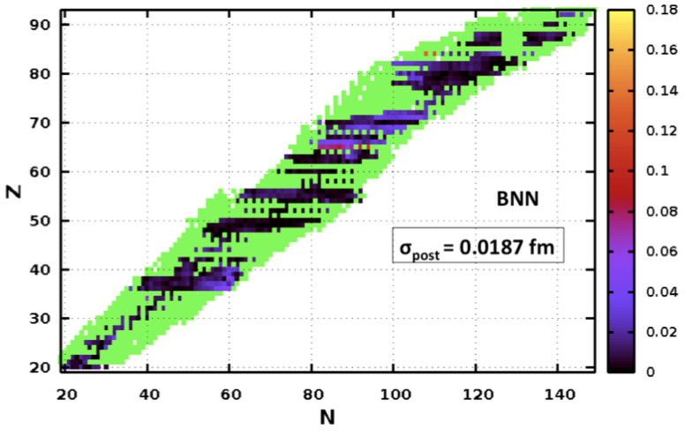
UQ, BML and extrapolations into unexplored domains
Residual of an observable O:
Smooth part of the residual represents missing physics
Estimate of an observable O:
Supervised learning: the nuclear modeling and the choice of priors represent two aspects of the supervision
emulator of the residual
Charge radii with BNN
R.Utama et al., J. Phys. G 43, 114002 (2016)

Slide 18
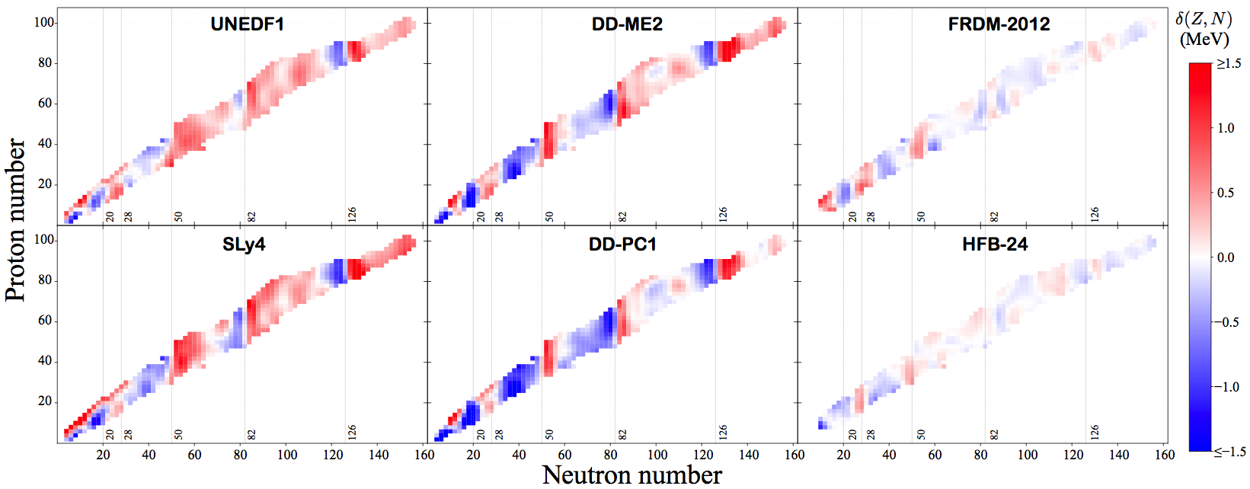
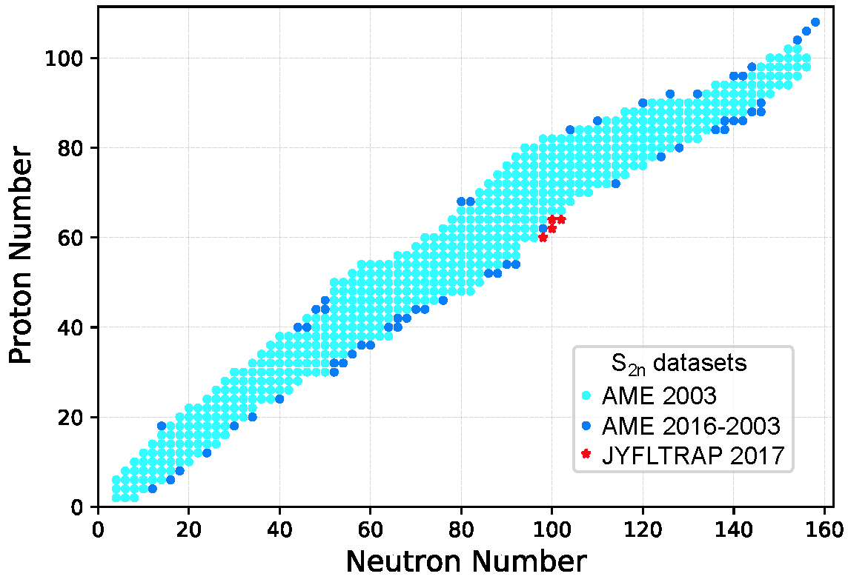
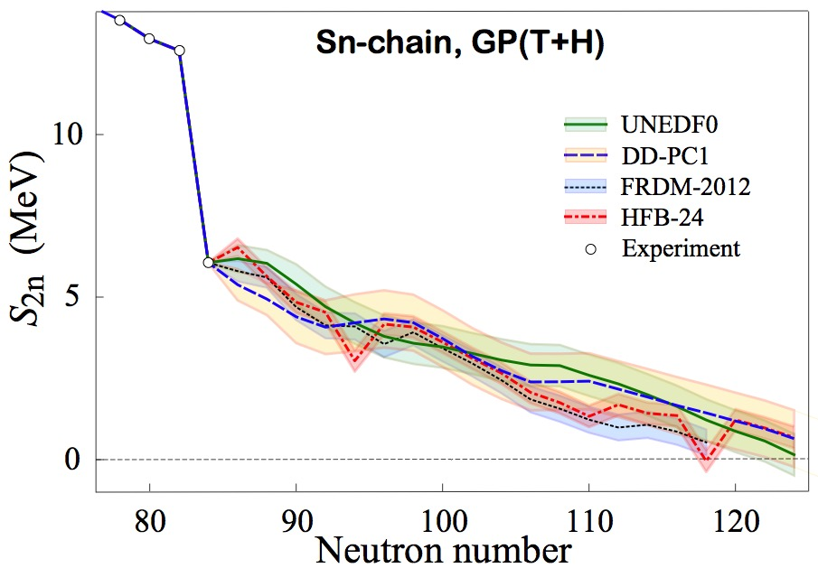
Mass extrapolations with BNN and GP
Neufcourt et al. Phys. Rev. C 98, 034318 (2018)
Residuals (based on data and theory) exhibit patterns
This information can be used to our advantage to improve model-based predictions!
It can also be used to improve models themselves
outcome
residual emulator
Training set
Testing sets

Slide 19
Naïve nuclear theorist’s approach to a systematic (model) error estimate:
Take a set of reasonable global models M_{i}, hopefully based on different assumptions/formalism, that satisfy basic theoretical requirements (here comes the expert belief thing)
Make predictions: E(y;M_{i})=y_{i}
Compute average and variation within this set
Compute rms deviation from existing experimental data.
Can we do better? Yes!
Model mixing:

Slide 20
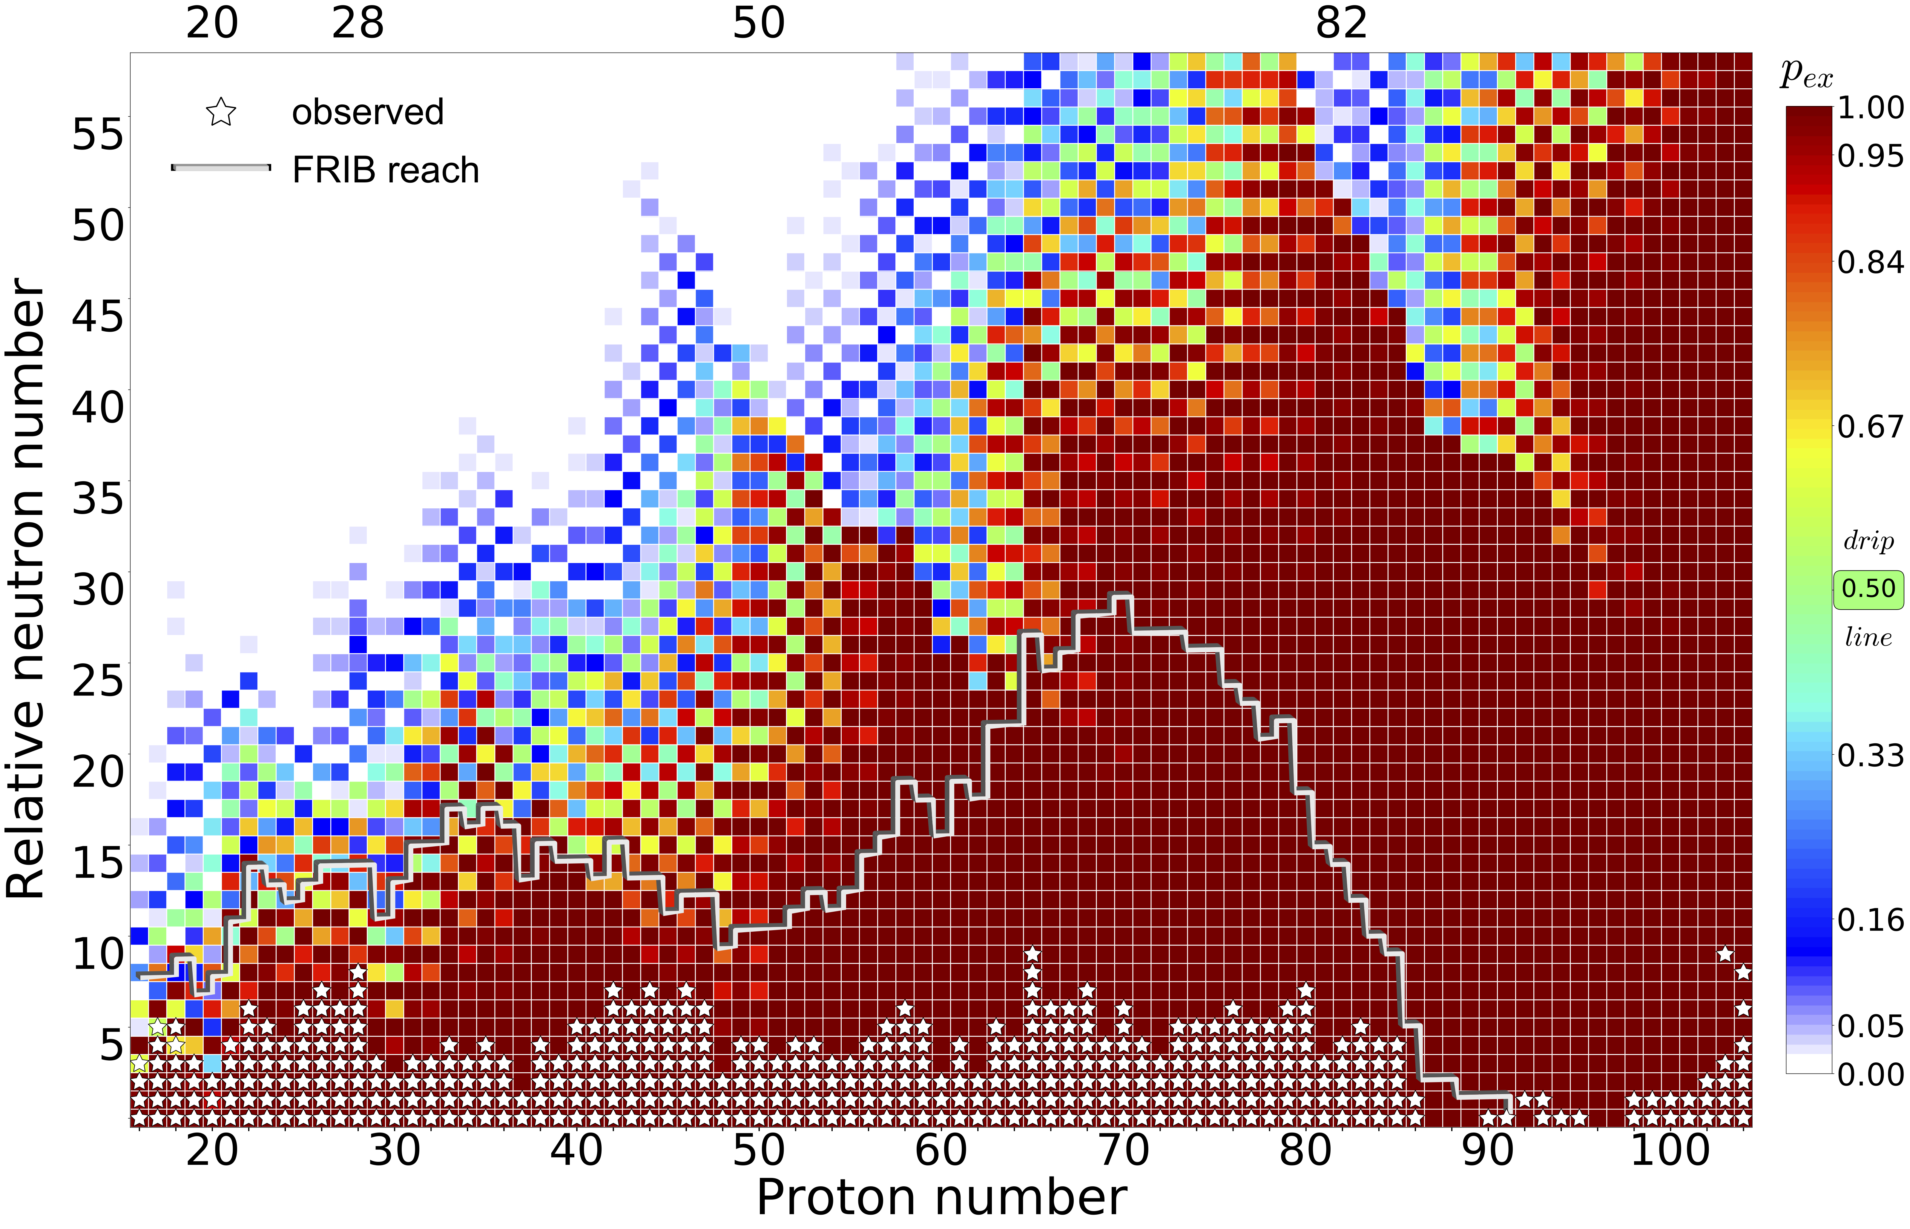
Quantified limits of the nuclear landscape using 11 global nuclear mass models with BMA Neufcourt et al., Phys. Rev. C 101, 014319 (2020); arXiv:2001.05924]
“0” corresponds is the neutron number of the heaviest isotope for which an experimental separation energy value is available

Slide 21
Education
AI is expected to play an increasing role in many areas of nuclear physics. Transfer of knowledge as well as developing collaborations with partners outside the traditional university sector are themes we expect will benefit society at large. Nuclear physics keeps attracting many brilliant young researchers and providing our workforce with AI/ML competences and skills for solving complicated physics problems is a compelling task for our community.
2012- A series of annual meetings on Enhancing the interaction between nuclear experiment and theory through information and statistics (ISNET): Kraków, Glasgow, ECT*, INT, York, Darmstadt, and Göteborg.
The next ISNET-8 will be held at FRIB during Dec. 14-17th, 2020:
https://indico.frib.msu.edu/event/21/
2019: a four-day long FRIB-TA summer school on ML methods in Nuclear physics, NSCL/FRIB, May 20-23, over 100 participants.
2019: Nuclear Talent course on Bayesian Methods and Machine Learning, York, June 10-28
2020: Nuclear Talent course on Machine Learning and Data Analysis applied to nuclear physics, ECT*, June 22-July 11

Slide 22
Summary
Many exciting results achieved but the best is yet to come!
The low-energy nuclear theory community is eager to embrace the diverse toolbox of tricks offered by AI.
To solve many complex problems in the field and facilitate discoveries, multidisciplinary efforts efforts are required involving scientists in nuclear physics, computational science, applied math, and statistics.
We need to invest in relevant educational efforts.
Needs and challenges (AI-literacy, interdisciplinary collaborations, workforce, education…) will be discussed by the Working Group in Room L102.
And, by the way…
…remember: Beam time and compute cycles are expensive!

Slide 23
Thank you!

